Slide 1

Quick Start With Astro-Data It’s not all Black and White with Pandas
Soheb Mandhai

Slide 2
Disclaimer
This session acts as a reference guide – I’m not a Python wizard by any means, I just have a couple of years of experience with it and am also learning.

Slide 3
Resources – Follow Along

Slide 4
Downloading Data

Slide 5
File Formats

Slide 6
Loading In Data Files

Slide 7
Processing Data Files

Slide 8
Visualising Data

Slide 9
Storing Data

Slide 10
TIPS

Slide 11

Pseudocode
Write out your algorithm in basic English – create a step by step guide of your logic:
Benefits: This lets anyone translate your algorithm to another programming language if needed
For example, Making Tea – The Algorithm:
Acquire Cup, Tea Bag, Milk, Sugar
Go to Kettle
Check Kettle Water
If water is low:
Refill water
Turn kettle on
Wait
Place Tea Bag in cup with Sugar (NOT MILK – I WILL FIND YOU)
While water == not hot:
Wait
If kettle == done:
water= hot
Pour Water into cup
Stir
Add Milk
Drink

Slide 12






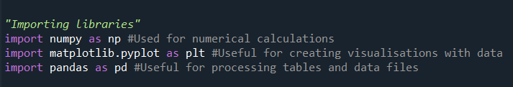
Common Libraries

Slide 13

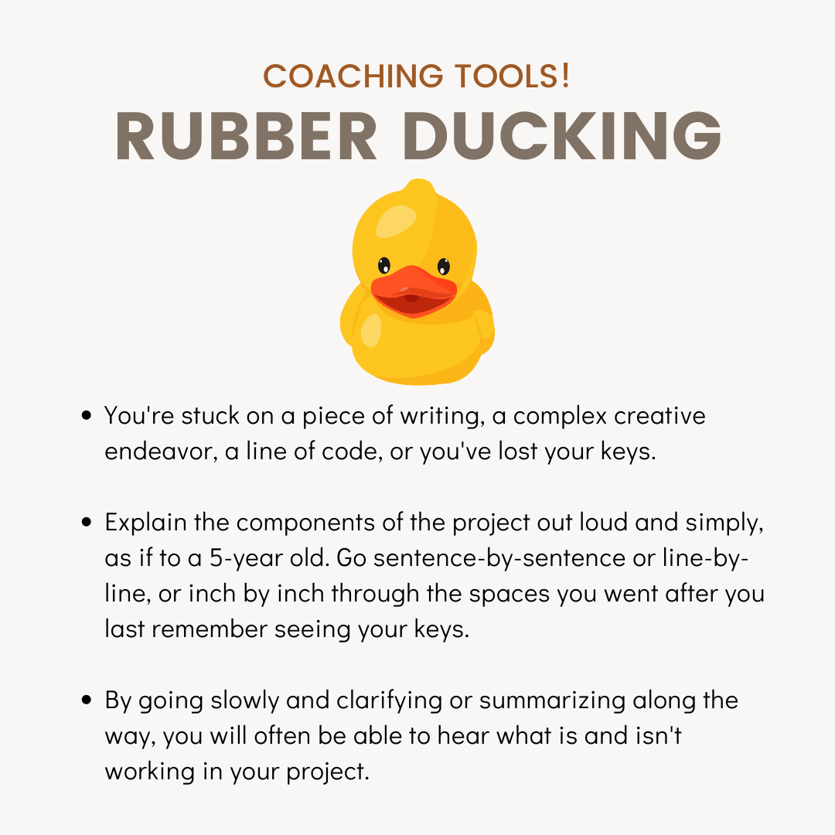
Debugging
Check variable explorer in an IDE to ensure values are what you expect
Narrate your code to a friend or a rubber duck (Rubber Ducking)
Use print statements around offending areas
Follow the traceback
Credit: V & CO Coaching

Slide 14
Environment Control

Slide 15
Document

Slide 16
Additional Resources

Slide 17

Need Help?
StackOverFlow
Your Colleagues
W3Schools
Coding Academy
Many More…

Slide 18

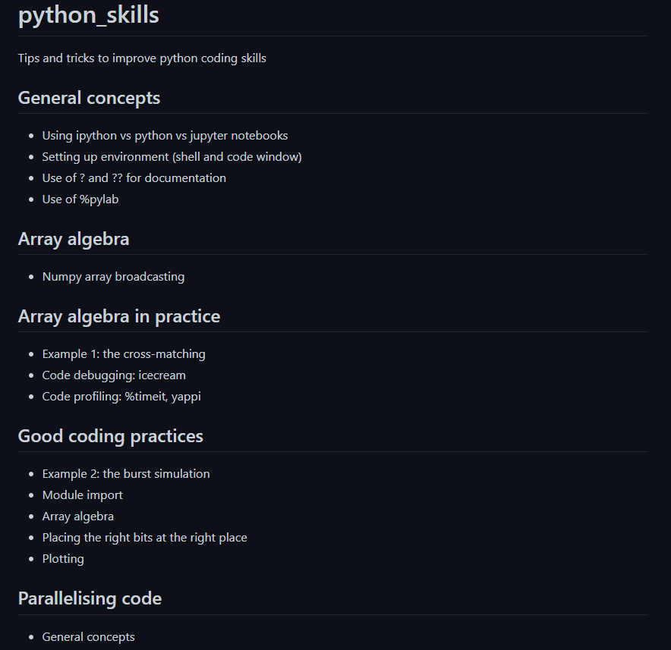
Want to be a Python Jedi?
Check out Rene’s JACS material from previous years - https://github.com/bretonr/python_skills

Slide 19
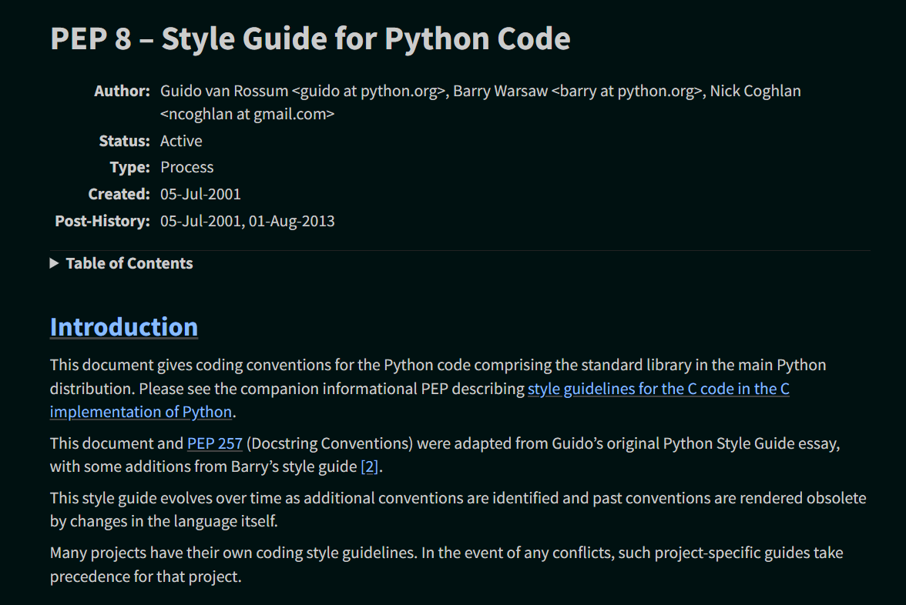
PEP-8 Documentation
Style Guide for Python Code- https://peps.python.org/pep-0008/

